Slide 1


IIT Madras
BS in Data Science And Application
Revitalizing Sales Strategy and Improving Inventory Management: A Business Data Management Project for Quadri Mobile Communication
Presented By :– Azhar Quadri
21f2000479
1

Slide 2
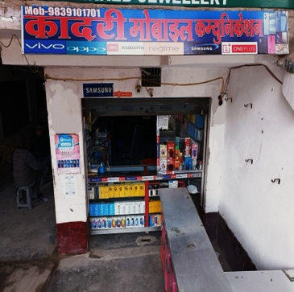
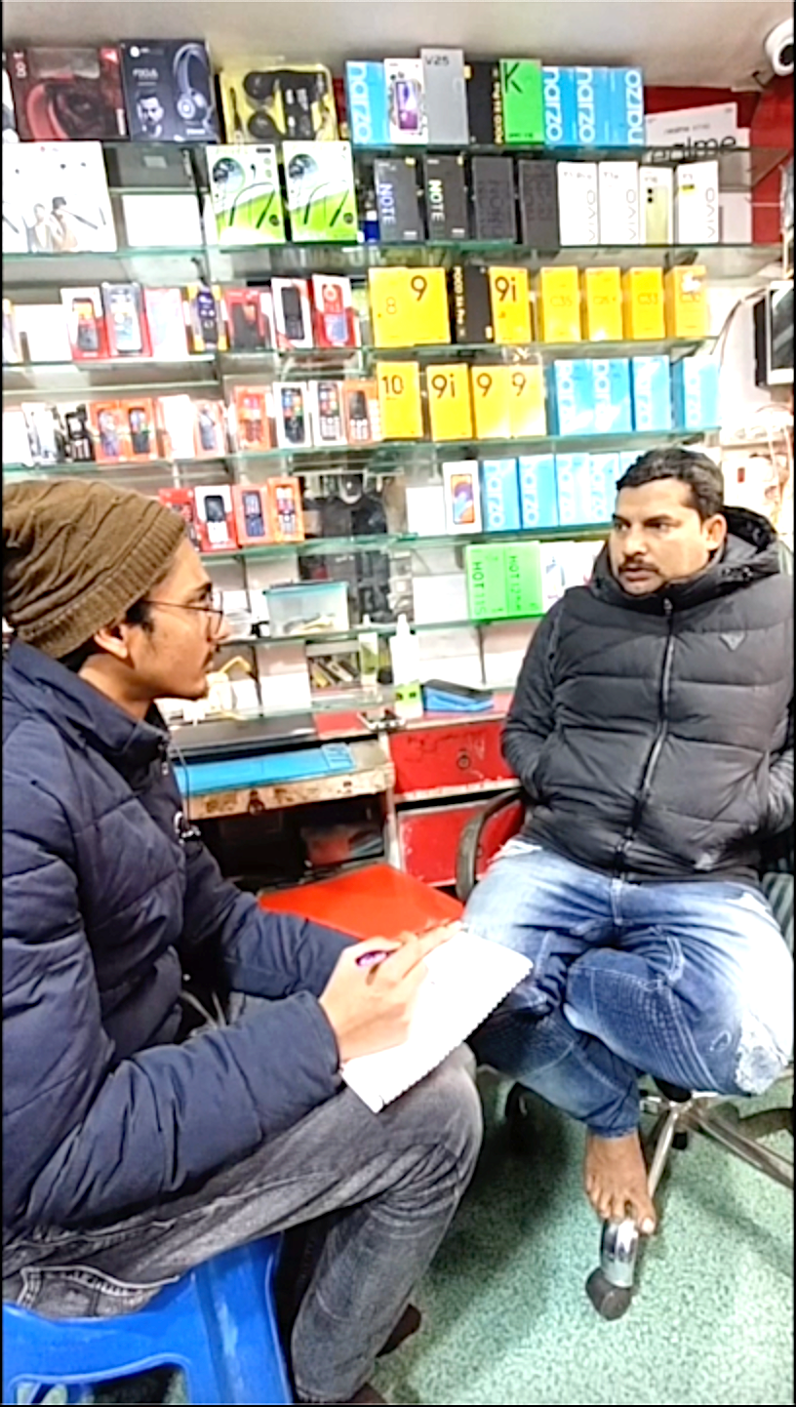
Business Background
➢ Business name:- Quadri Mobile Communication
➢ Business type:- Retail Mobile Phones Store
➢ Location:- located in prominent area of town Dildarnagar, Ghazipur, UP
➢ Owner:- Mr. Azad Khan
➢ Management
Primarily run by Mr. Azad with assistance from his relative, Mr. Faisal
Mr. Azad has intermediate education and strong sales experience.
➢ Years in operation:- Since 2015
Problem Statements
1
2
3
Inadequate Product Range
Suboptimal Pricing Strategy
Inefficient Inventory Management
2
problem of reaching a large customer base.

Slide 3
Objective
To identify the business problems and find a way out to solve those problems to help the shop owner run the business in a better way.
PROBLEM SOLVING APPROACH
Data Collection
Data Cleaning
Analysis & Visualizations
Insights
Recommendations
Gathered sales, inventory, and expense data through interviews and records.
Removed duplicates, handled missing values, and standardized entries for analysis.
Created visualizations to understand the patterns (Bar charts, Pareto analysis, Scatter plots).
Identified high-demand products requiring frequent restocking, overstock in low-demand models, and pricing inefficiencies.
Recommended demand-driven inventory management with regular restocking of high-demand products, optimized allocation for top-performing brands like Xiaomi and Realme, and focus on budget segment models to meet customer preferences.
Prepare for peak months like November by stocking up and launching festive promotions, while optimizing pricing for low-demand models through discounts or bundling. Use a Point of Sale (PoS) system to monitor sales, inventory, and finances for better profitability.
3

Slide 4
Data Analysis Process
Steps Taken:
1. Data Cleaning: Removed duplicates, handled missing values, standardized product names to ensure consistency like “Samsung Galaxy A12” and “Galaxy A12” into a single entry.
2. Visualization: Created custom visualizations using Excel and Python libraries(matplotlib, seaborn).
• Bar charts for sales performance.
• Pareto analysis for revenue distribution.
• Line chart for trends and patterns.
3. Metrics Calculation:
• Analyzed inventory turnover to identify fast-moving and slow-moving products.
• Calculated profit margins to focus on high-margin products.
• Tracked sales trends to detect peak periods and customer preferences.
Tools Used:
• Excel: Initial cleaning and basic analysis.
• Python: Advanced analysis and custom visualizations.
4

Slide 5
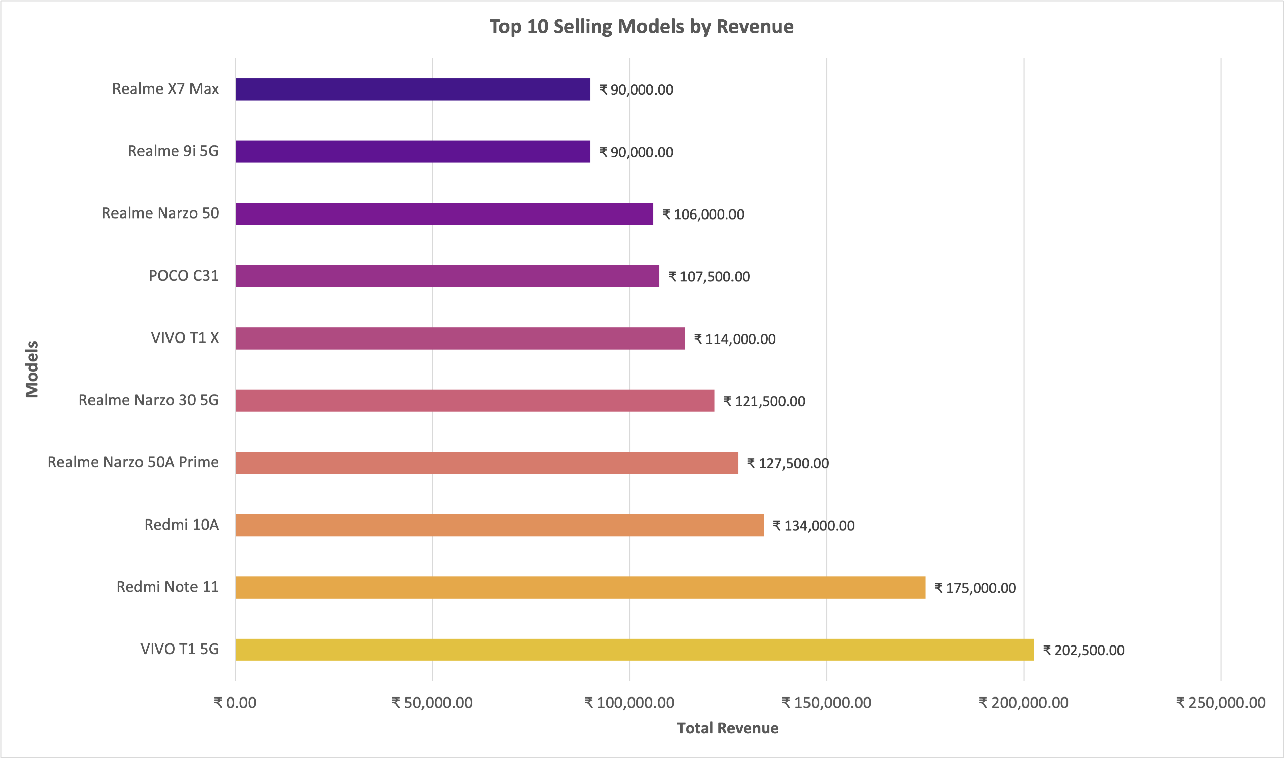
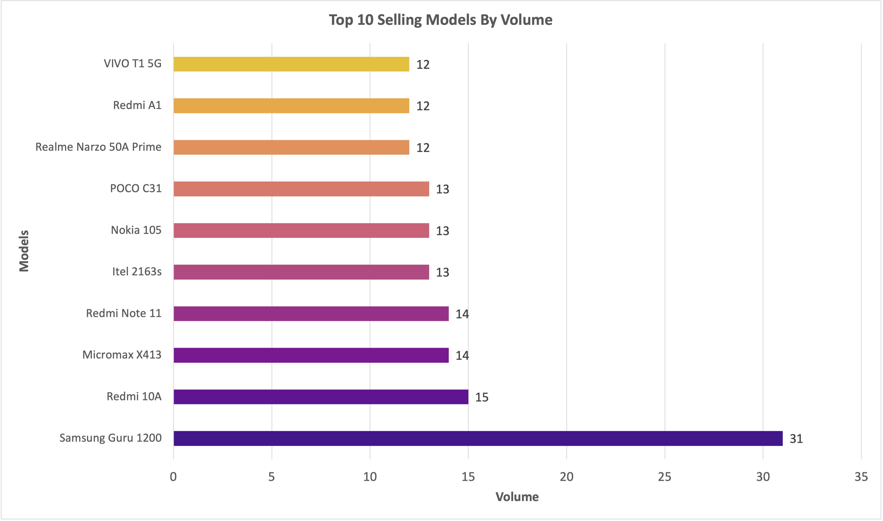
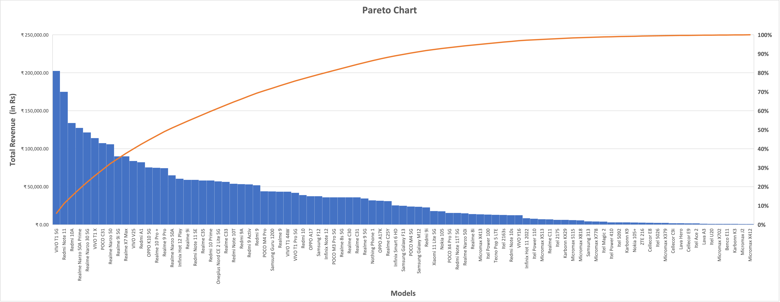
Sales Performance Insights
Models like Vivo T1 5G dominate revenue due to high margins.
Budget models like Samsung Guru 1200 lead in volume due to affordability.
High sales volume does not always translate to high revenue.
Revenue is distributed more evenly across models, indicating diverse customer preferences.
Unlike typical Pareto distributions, the business relies on a broader range of products for revenue.
5

Slide 6
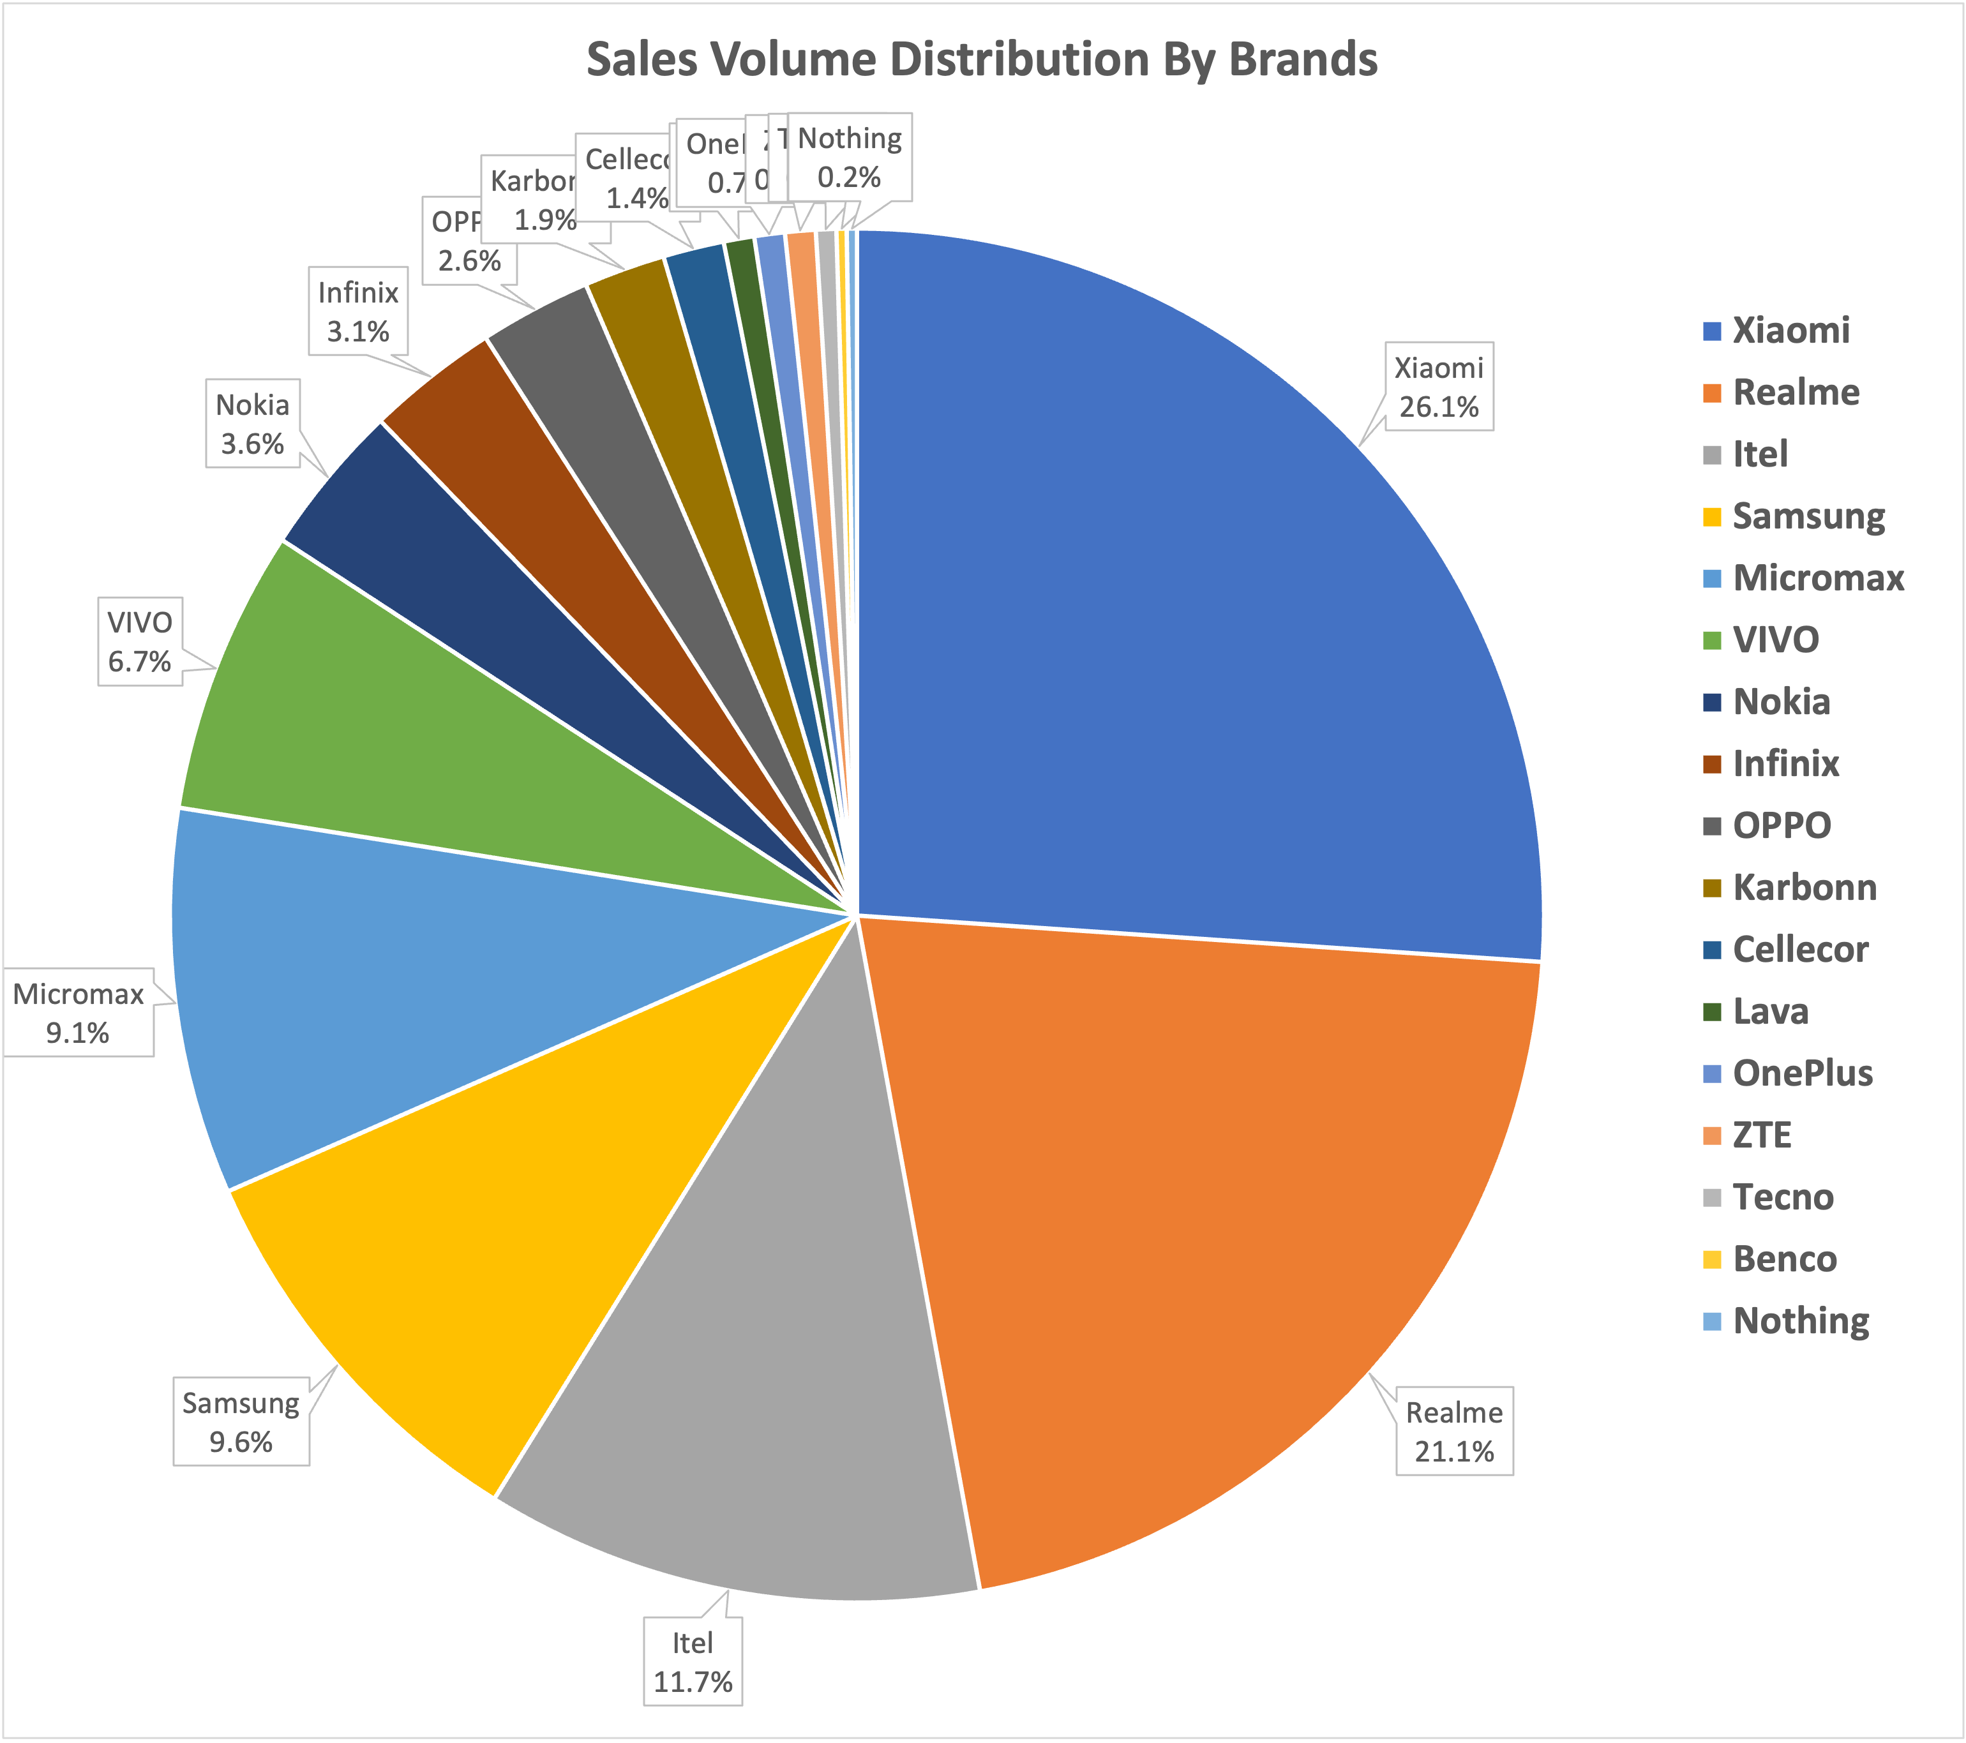
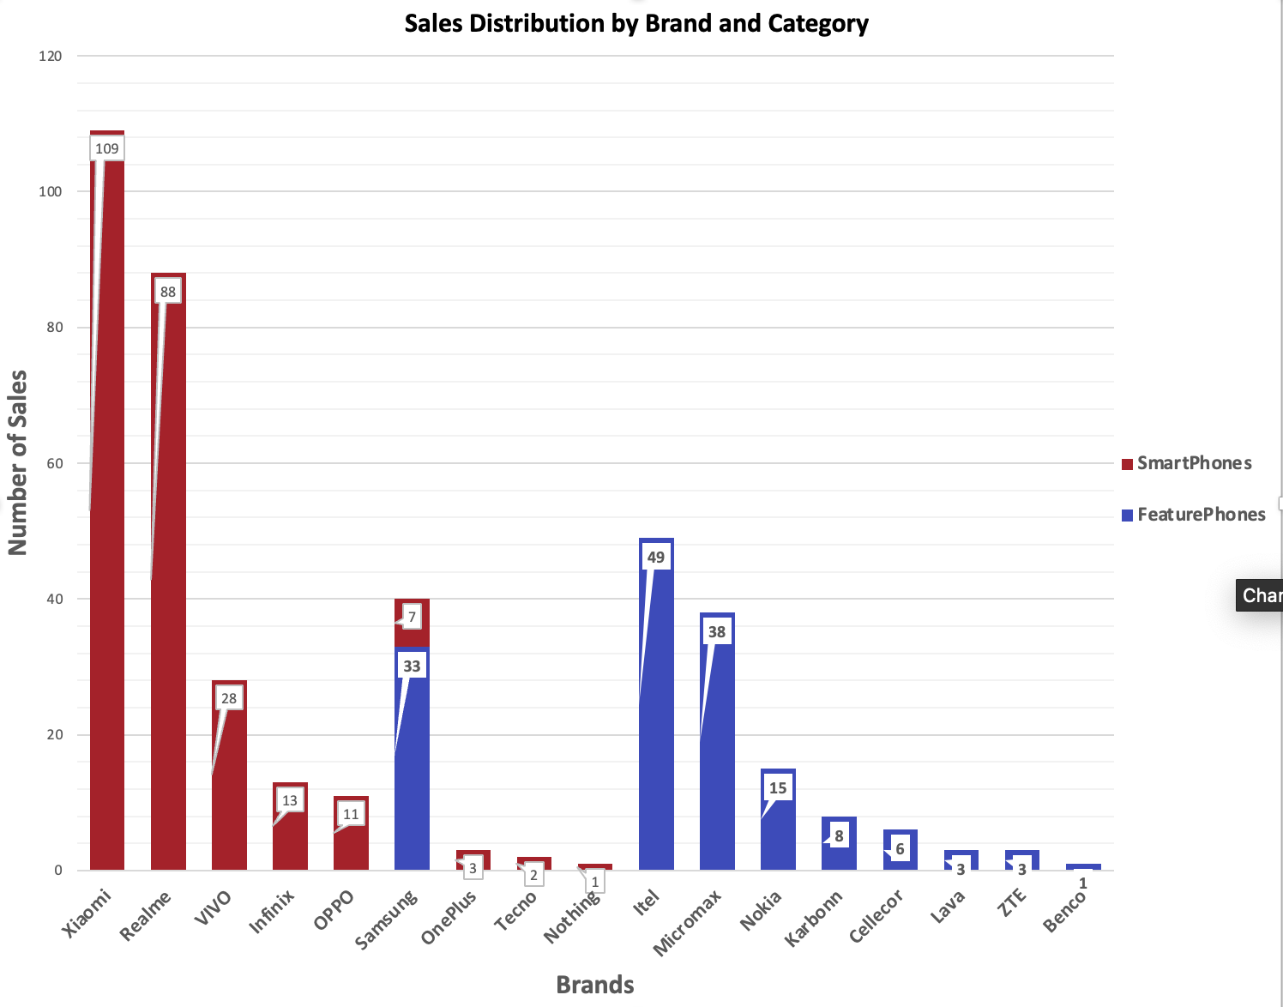
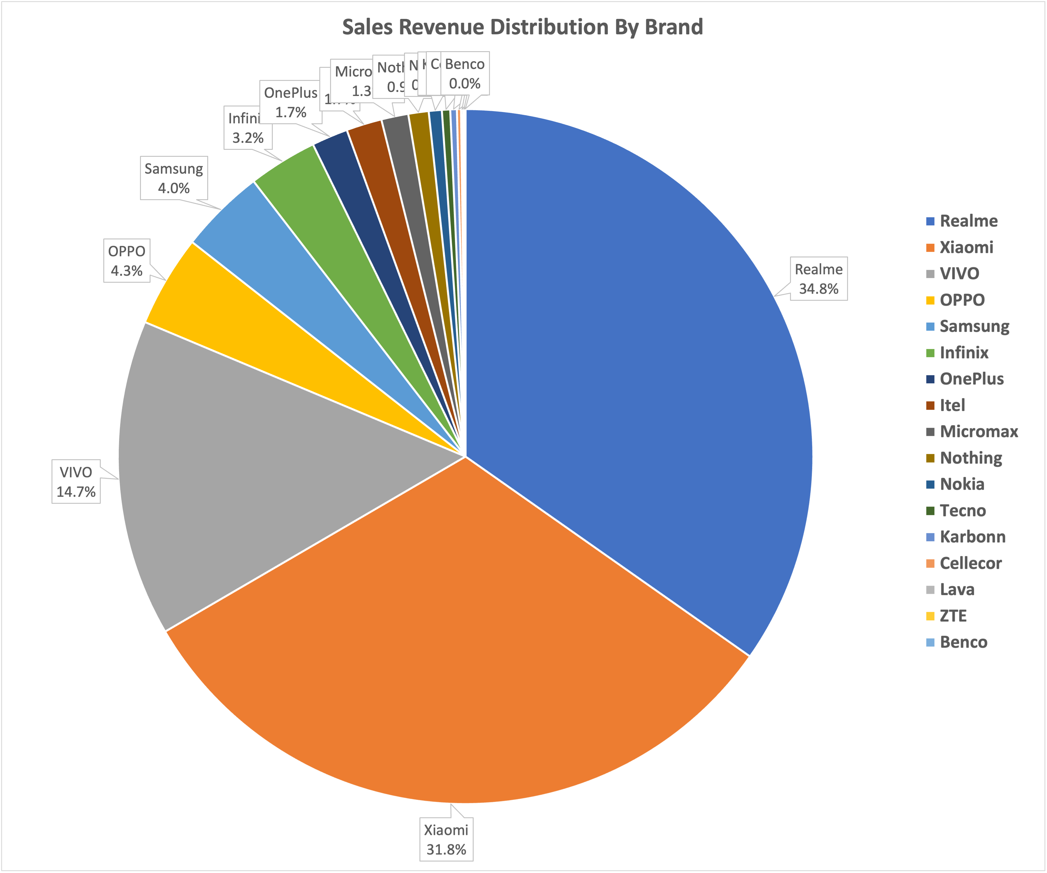
Brand and Category Insights
Xiaomi and Realme dominates in both Revenue and Sales Volume
Itel have approx. 12% sales volume but contribute too low in revenue(approx. 1.5%) which indicates lower price margin.
Samsung too have same pattern
Realme though have 21% sales volume but contributes 35% in revenue indicating higher margin
Smartphones Brand contributes major in revenue due to their higher price margin
Featurephones Brand despite being high in volume contributes too low in revenue
Samsung is the only brand having both category product for sales (Featurephone as well as Smartphone).
Most of the Samsung sales occurred in featurephone category.
Itel is the most sold Brand in Featurephone category while Xiaomi is the most sold brand in Smartphone category.
6

Slide 7
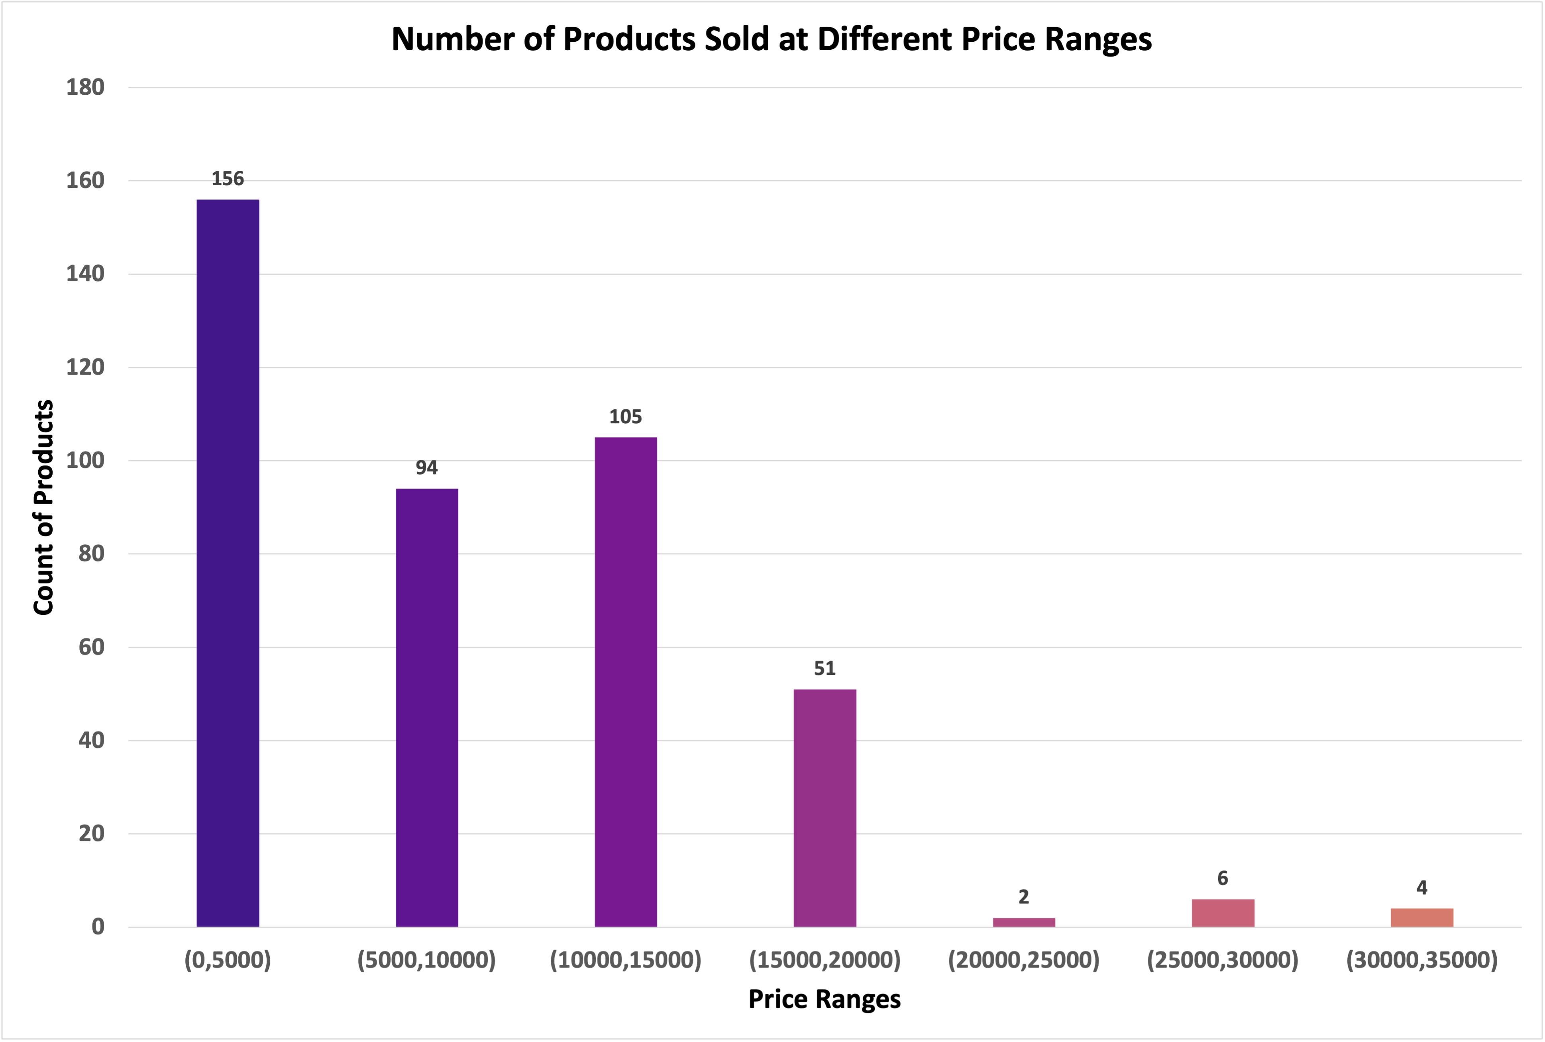
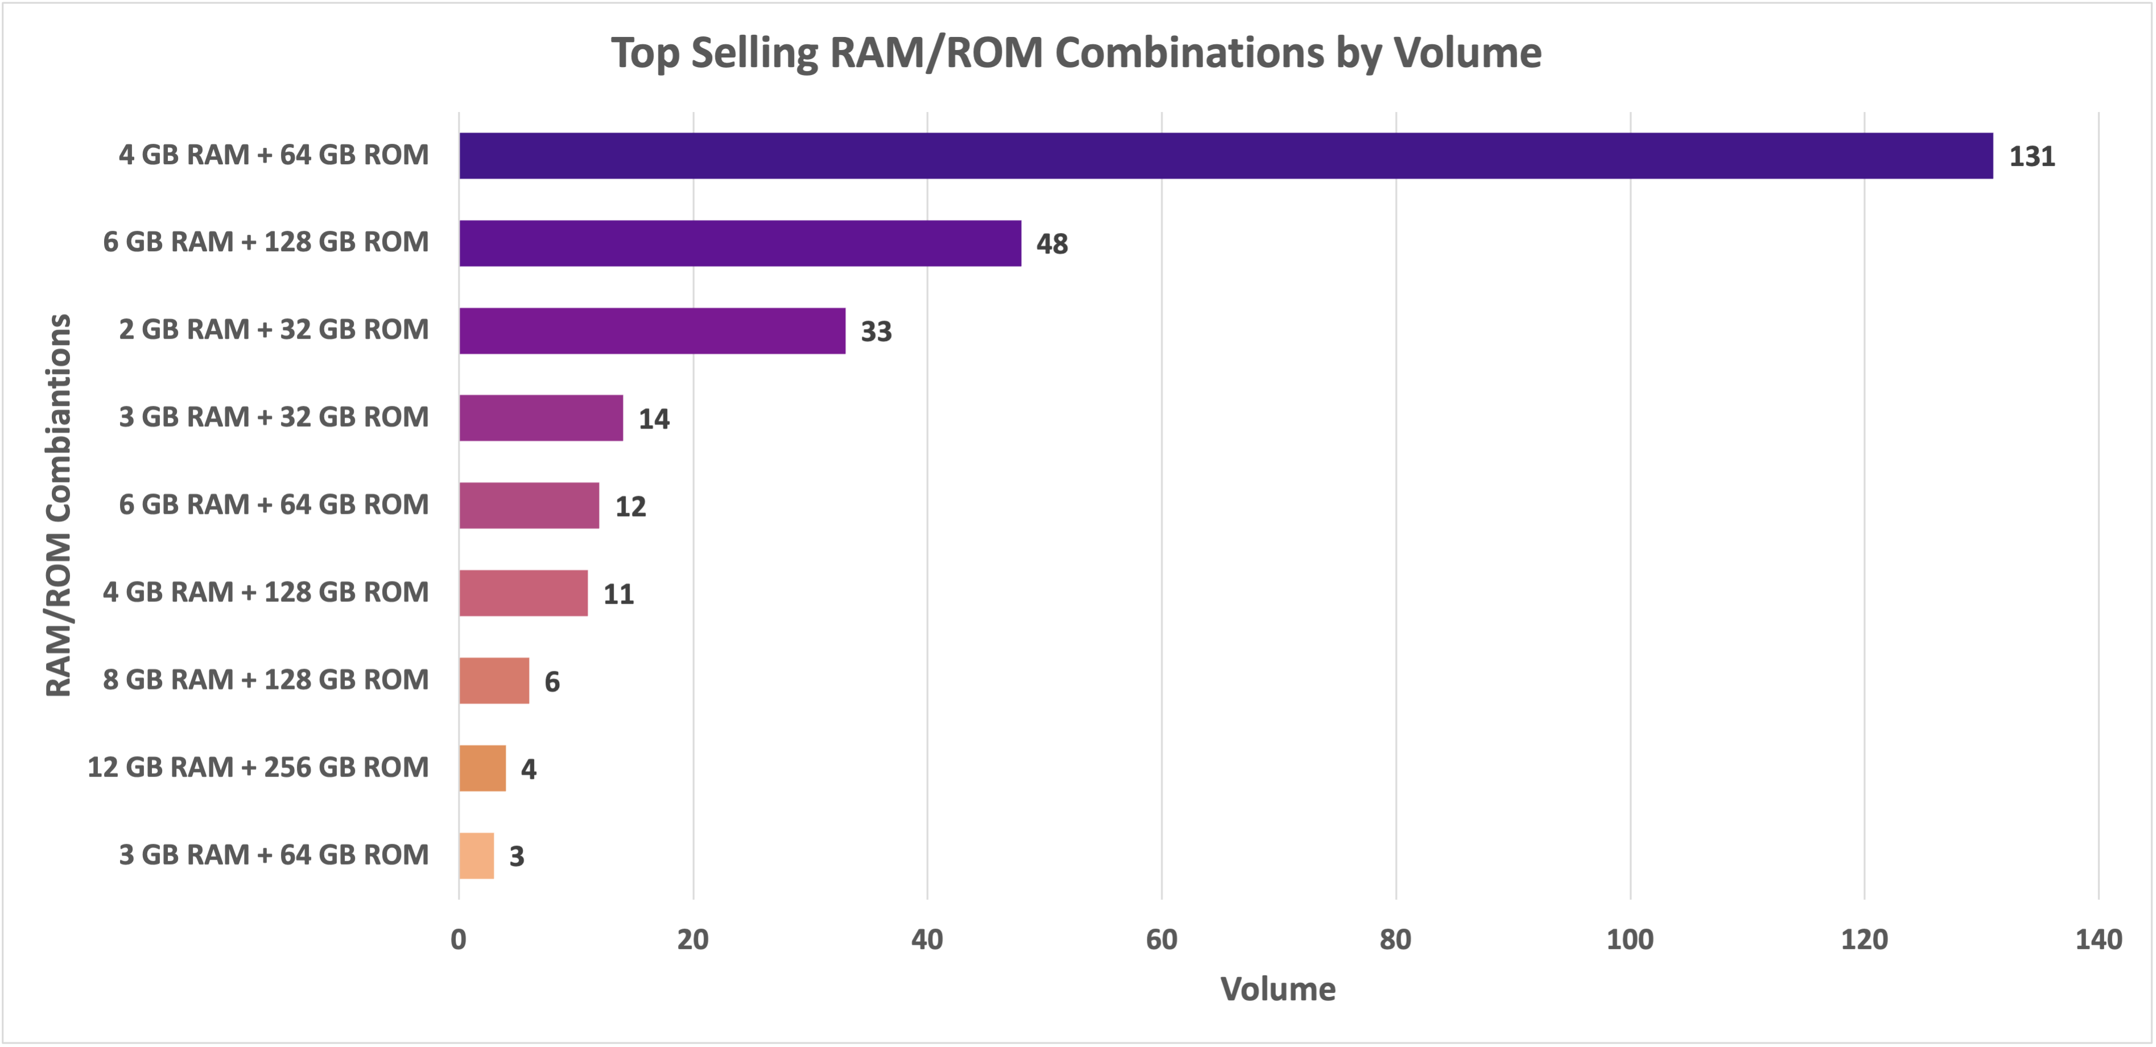
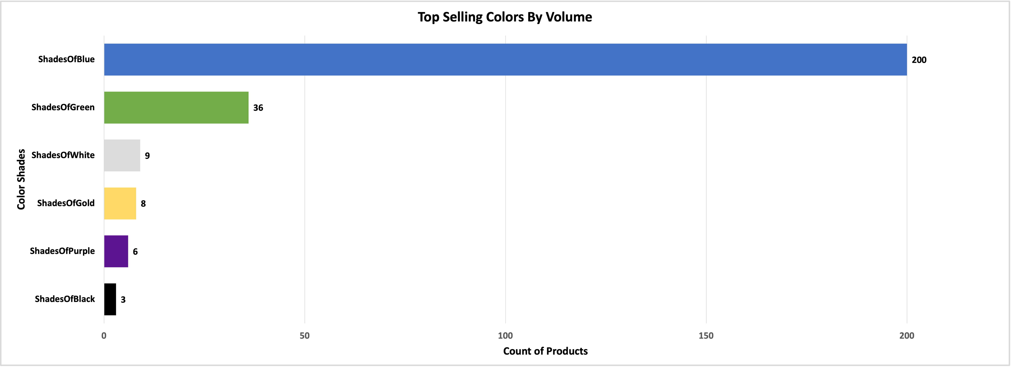
Customer Preferences
Budget Models with 4GB RAM and 64GB Storage have high demand in the market
High volume in low price ranges suggests the preference for budget friendly products
Shades of Blue have the significant most demand in the market and then shades of Green
Black is the least sold color infers customer demand funky colors
7

Slide 8
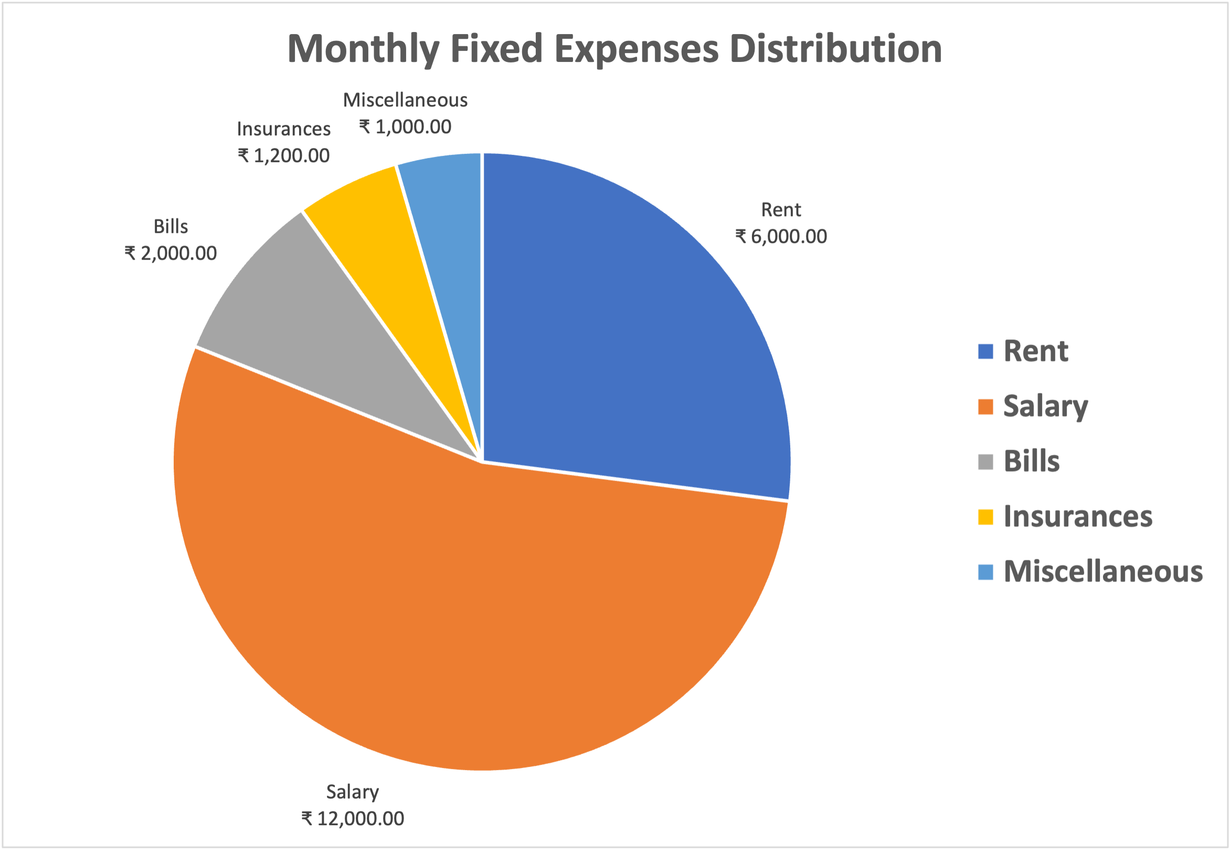
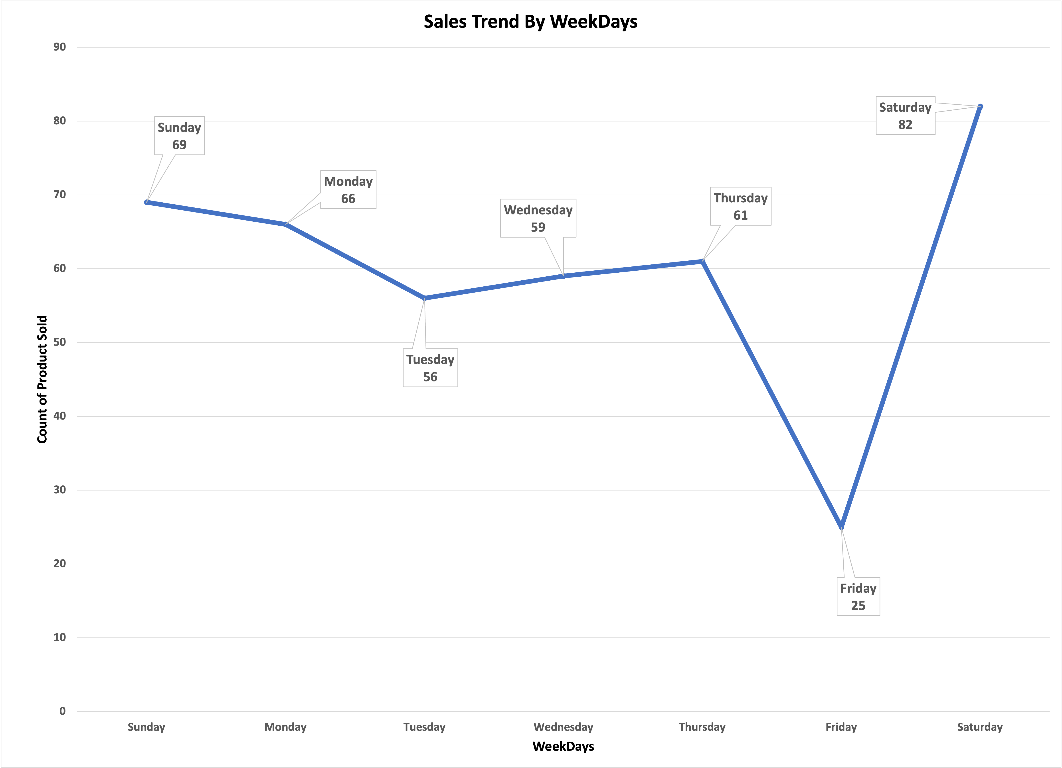
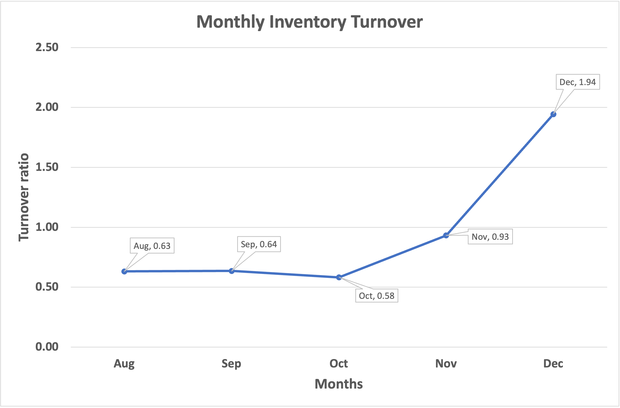
Inventory and Expenses Insights
Major Monthly expenses are Rent and Salary (more than 75 percent)
The highest turnover, 1.94, is observed in Dec infers strong sales performance or efficient inventory management (less stock carried forward).
Except for December, average inventory remains relatively high throughout the year, which might hint at over-purchasing or slow movement of some stock categories.
Sales are highest on Saturday (82 units) and Sunday (69 units), while Friday (25 units) has the lowest sales.
Customer prefers Weekends to shop more
Since Market is closed on Friday it witnesses lower sales
8

Slide 9
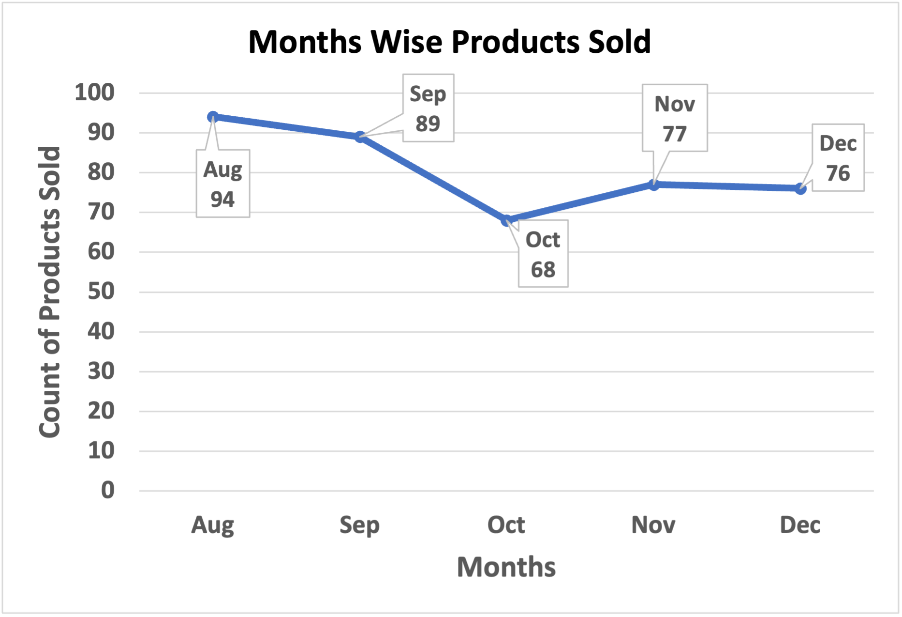
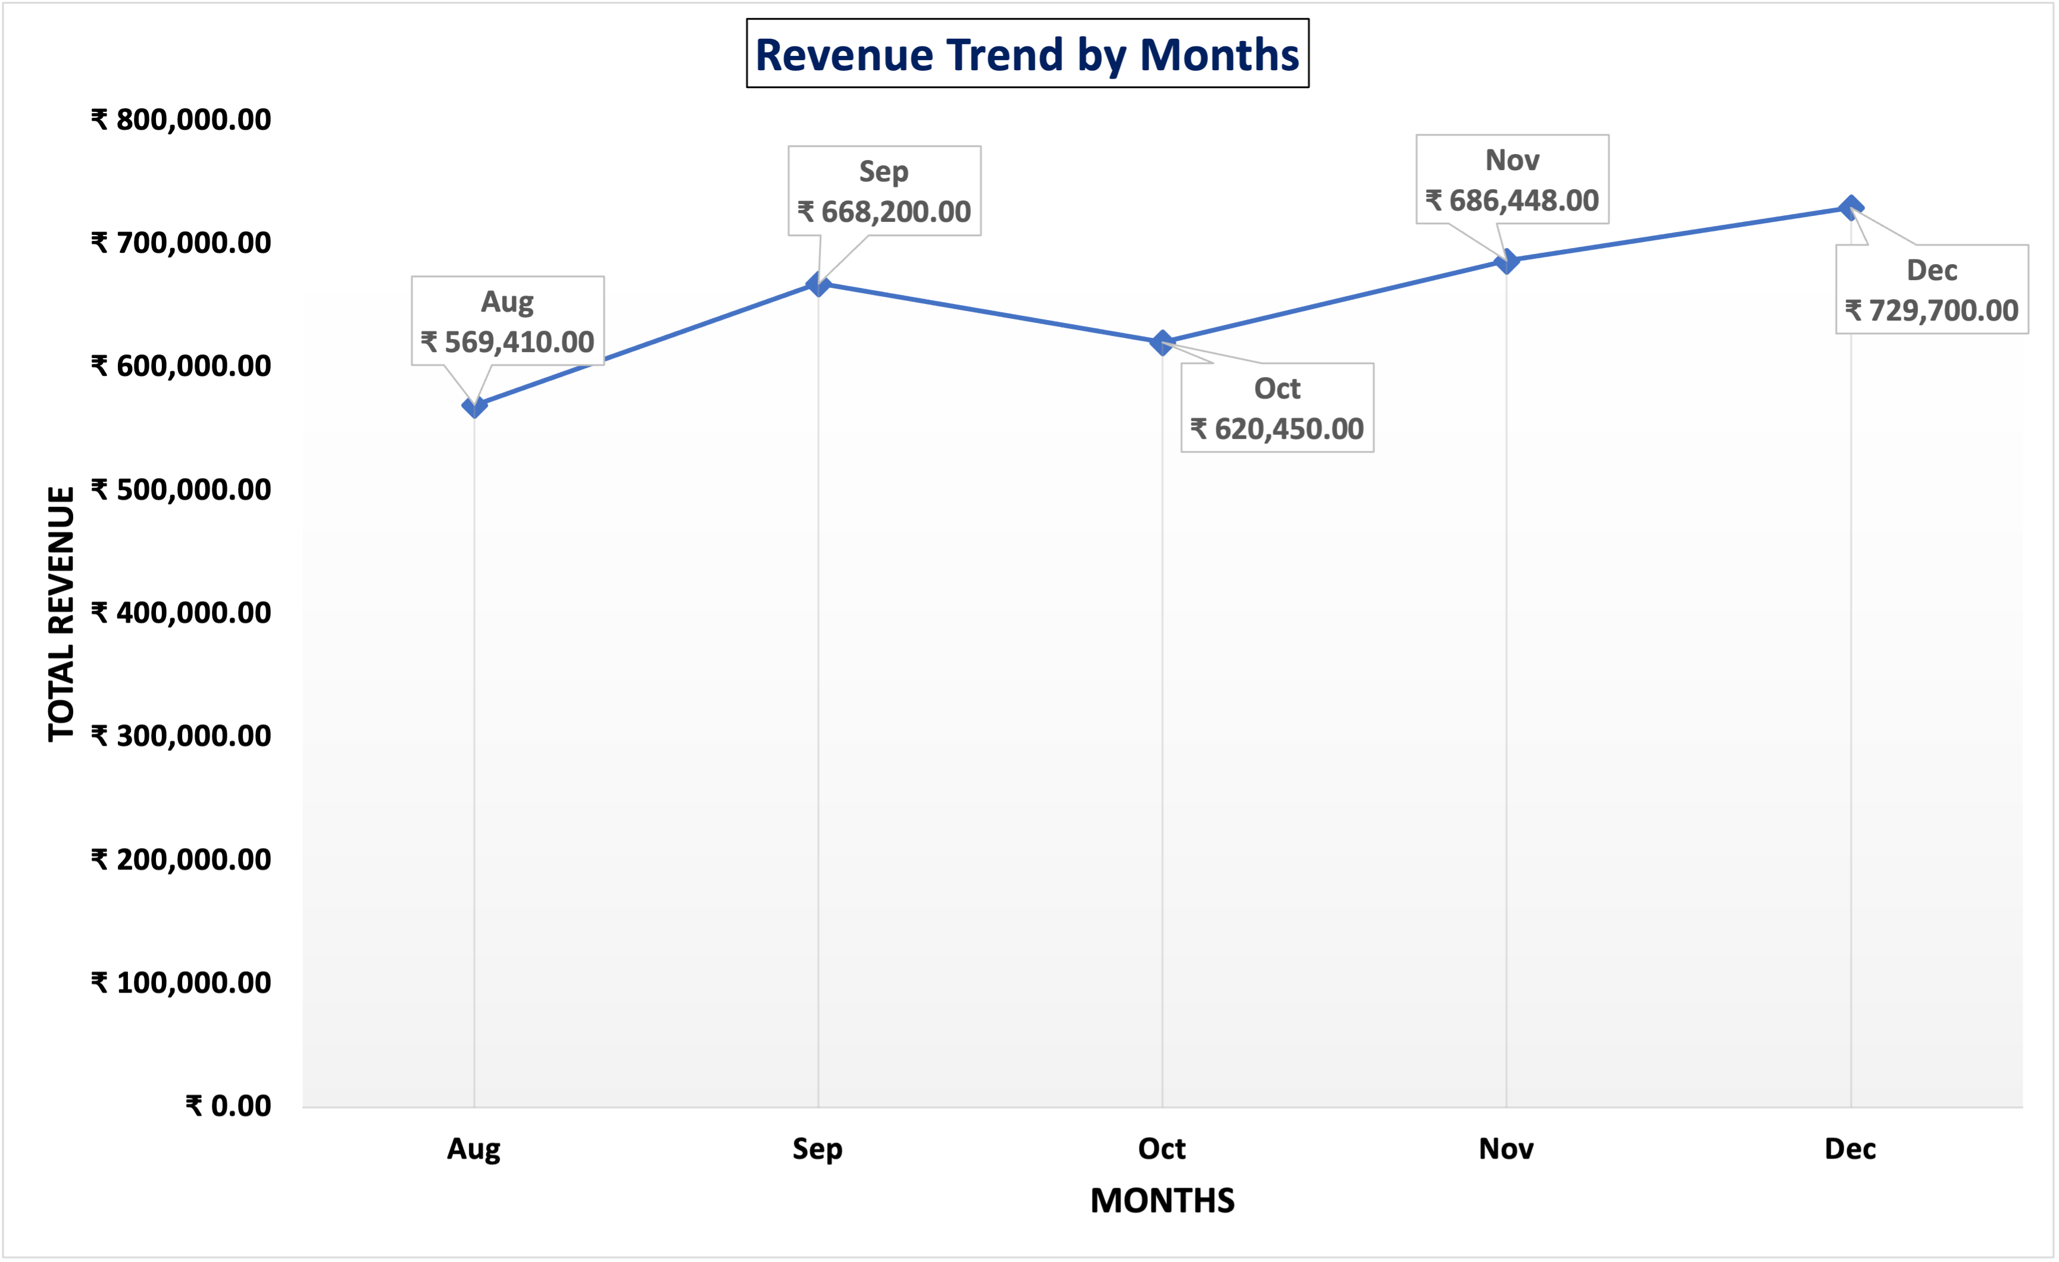
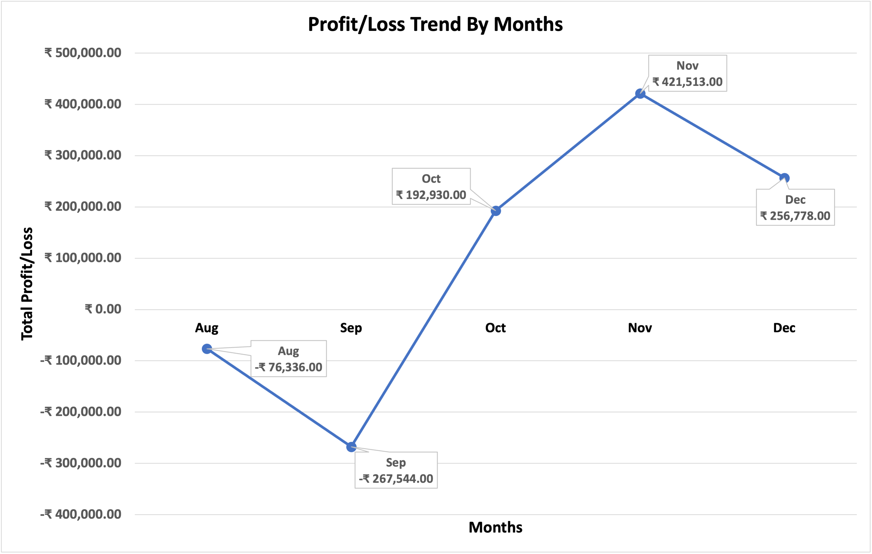
Sales Patterns and Trends Insights
Revenue steadily increased from Aug(₹569,410) to December (₹729,700).
Peak revenue was observed in December, suggesting strong sales during the holiday season.
Sales dropped significantly between August and October, with October being the lowest month at 68 units.
Sales picked up in November (likely due to holiday shopping and offers) and remained stable in December.
It is noted that though the volume trend is in downwards monthwise but the revenue is in uptrend.
Gross and operating profits were negative from Aug to Sep, indicating operational inefficiencies or excessive costs.
Profitability improved in Oct to Dec, with peak profits in Nov.
9

Slide 10
Recommendations
Regular restocking of high-selling products with popular configurations to meet customer demand efficiently.
Allocate inventory based on brand performance insights, ensuring popular brands like Xiaomi and Realme have adequate stock.
Focus on Budget Segment latest launching models as the customer mostly prefers budget phones.
Regularly monitor competitor pricing to remain competitive, especially in the budget segment where affordability drives volume.
Prepare in advance for peak months like November by stocking up on high-demand models.
Launch festive promotions during peak months to drive sales and increase footfall.
Optimize pricing for low-demand models by offering discounts or bundling them with accessories to clear inventory.
Reduce overstock of slow-moving models to minimize holding costs and optimize space.
Use any PoS(Point of Sale) software to gather and monitor sales and inventory record and also the finances to optimize the profit.
10

